Slide 2
Principles
The use of information systems to add value to the organization is strongly influenced by organizational structure, and the organization’s attitude and ability to change
Because information systems are so important, businesses need to be sure that improvements to existing systems, or completely new systems, help lower costs, increase profits, improve service, or achieve a competitive advantage
Cooperation between business managers and IS personnel is the key to unlocking the potential of any new or modified system

Slide 3
An introduction to organizations
An organization is a formal collection of people and other resources established to accomplish a set of goals
An organization is a system, which means that it has inputs, processing mechanisms, outputs, and feedback
Resources such as materials, people, and money are the inputs
These go through a transformation mechanism, the processing
The outputs from the transformation mechanism are usually goods or services, which are of higher relative value than the inputs alone
Through adding value or worth, organizations attempt to achieve their goals

Slide 4
The value chain
The value chain is a useful tool for analyzing where and how this value gets added
The value chain is a series (chain) of activities that includes inbound logistics, warehouse and storage, production, finished product storage, outbound logistics, marketing and sales, and customer service
The value chain is used to examine what happens to raw material to add value to them before the finished product gets sold to customers
Information systems can be developed to focus on those activities that add the most value

Slide 5
SRM & CRM
Supply chain management (SCM) and customer relationship management (CRM) are two key parts of managing the value chain
SCM helps determine what supplies are required for the value chain, what quantities are needed, how they should be turned into finished products and shipped to customers
Increasingly, SCM is accomplished using the Internet and B2B e-commerce
CRM programs help a company manage all aspects of customer encounters, including marketing and advertising, sales, customer service after the sale, and help retain loyal customers

Slide 6
IS in SCM & CRM
What role does an information system play in SCM & CRM?
A traditional view of information systems holds that organizations use them to control and monitor processes and ensure effectiveness and efficiency
A more contemporary view, however, holds that information systems are often so intimately involved that they are part of the process itself
This gives a new perspective on how and why businesses can use information systems
Managers should consider the potential role of information systems within business processes, which often leads to the discovery of new and better ways to accomplish the process

Slide 7
Organizational structures
Organizational structure refers to organizational subunits and the way they relate to each other. An organization’s structure depends on its approach to management, and can affect how it views and uses information systems
The types of organizational structures typically include:
  Traditional
  project & team
  virtual

Slide 8
Traditional organizational structure
This is a managerial pyramid where the hierarchy of decision making and authority flows from the strategic management at the top, down to operational management and non-management employees
Those at the top have a higher degree of decision authority, more impact on business goals, and more unique problems to solve
Today, the trend is to reduce the number of management levels, or layers, in the traditional organizational structure
This type of structure is often called a flat organizational structure

Slide 9
Project and team organizational
structures
A project organizational structure is centred on major products or services
Each major product has its own marketing, finance and production departments
The team organizational structure is centred on work teams or groups
Teams can be small or large, permanent, or temporary
A healthcare company, for example, could form small teams to organize its administrators, doctors, and others to work with individual patients

Slide 10
Virtual organizational structure
A virtual organizational structure is made up of individuals, teams, or complete business units that work with other individuals, teams, or complete business units in different geographic locations
This almost always requires the use of the Internet (or other telecommunications) to facilitate communication
The people might never meet physically, which is why they are called virtual
A company can use a virtual organizational structure with its own dispersed workers who have distinct skills and abilities to reduce costs

Slide 11
Organizational change
Most organizations are constantly undergoing change, both minor and major
The need for organizational change can come from new managers, staff leaving, activities wrought by competitors or stockholders, new laws, natural occurrences (such as a hurricane), and changes in general economic conditions
An new IS will cause change
When a company introduces a new information system, a few members of the organization must become agents of change – champions of the new system and its benefits
Understanding the dynamics of change can help them confront and overcome resistance so that the new system can be used to maximum efficiency and effectiveness

Slide 12
Reengineering and continuous
improvement
To stay competitive, organizations must occasionally change the activities, tasks, or processes they use to achieve their goals
Reengineering, also called process redesign and business process reengineering (BPR), involves the radical redesign of business processes, organizational structures, information systems, and values of the organization to achieve a breakthrough in business results
Continuous improvement involves constantly seeking ways to improve business processes and add value to products and services

Slide 13
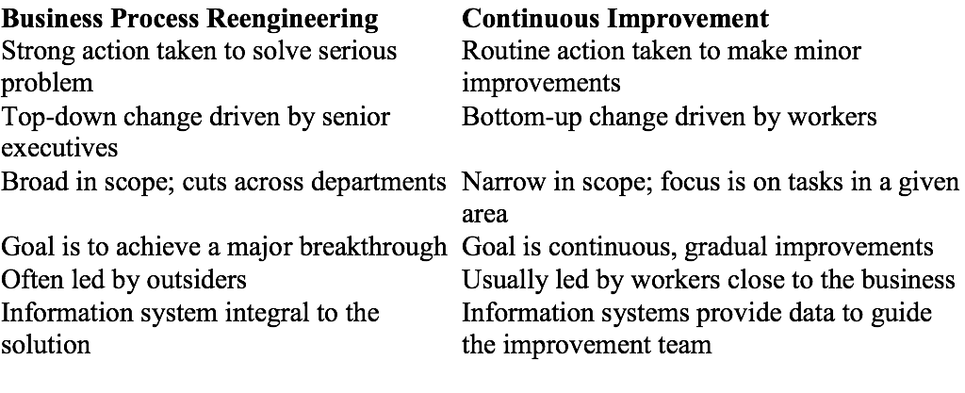
Comparing BPR and continuous
improvement

Slide 14
User satisfaction and technology
acceptance
To be effective, reengineering and continuous improvement efforts must result in satisfied users and be accepted and used throughout the organization
Technology diffusion is a measure of how widely technology is spread throughout an organization. An organization in which computers and information systems are located in most departments and areas has a high level of technology diffusion
Technology infusion is the extent to which technology permeates an area or department. In other words, it is a measure of how deeply embedded technology is in an area of the organization
An organization might have a high level of diffusion and infusion, but this does not necessarily mean that information systems are being used to their full potential

Slide 15
The applications portfolio
The applications portfolio classifies information systems according the contribution they make to the business:
Support applications are nice to have, but not essential
Key operational applications are essential and without them, the organization would not be able to do business
Strategic applications are information systems that give a business an advantage over some or all of its competitors
Potential strategic application (also known as a future strategic or high potential application) is an idea for, or a prototype of, an information system which, if developed, might one day become a strategic system
The portfolio is used to visualize what systems are currently in use, and plan out new development projects

Slide 16
Success factors
It is of vital importance that a company’s information systems are aligned with the company’s goals
The main way of achieving alignment is for senior managers to consider the business processes they have in place to achieve company goals, and ask, what information systems are needed to support these business processes
Less frequently a business, typically a small business or even a single entrepreneur, will consider what technology is available to them and ask, what business goals can be achieved with it
Other success factors include:
  Senior management must be committed
  End-users of the system should be involved in the development
  Time must be taken to carefully determine requirements
  Strong project management

Slide 17
Competitive advantage
A competitive advantage the ability of a firm to outperform its industry, that is, to earn a high rate of profit than the industry norm
It can result from higher-quality products, better customer service, and lower costs
Often, a competitive advantage will depend on a carefully designed information system

Slide 18
Evaluating IS
Once an information system has been implemented, management will want to assess how successful it has been in achieving its goals. Often this is a difficult thing to do, and many businesses do not attempt to take anything more than an informal approach to evaluation
Some approaches to evaluating IS include:
  Productivity: examine how output has changed since implementation
  Return on Investment: examine how profits have increased
  Earnings Growth: another measure of profit increase
  Market Share: examine the change in market share since implementation
  Customer Awareness and Satisfaction: possibly qualitative measure of satisfaction
  Total Cost of Ownership: estimate the total cost of the IS breaking cost into areas such as the cost to acquire the technology, technical support, administrative costs, and end-user operations

Slide 19
Careers in Information Systems
Chief Information Officer
LAN administrators
Internet Careers: Web operations, Web development, and Web administration
System developers
Technical writing
User interface design
Database administration

Slide 20
Summary
An organization is a system – has inputs, processing mechanisms, outputs, and feedback
Categories of organizational structure: traditional, project, team, and virtual
Reengineering: radical redesign of business processes, organizational structures, information systems, and values of the organization to achieve a breakthrough in business results
Continuous improvement: constantly seeking ways to improve business processes

Slide 21
Summary (continued)
Productivity: a measure of output achieved divided by input required
Primary responsibilities in information systems: operations, systems development, and support
Typical IS titles: Chief Information Officer (CIO), LAN administrators, Internet strategists and administrators, Internet systems developers, Internet programmers, and Internet or Web site operators

